Slide 1

IntelliDoc Reviewer AI-Agent: An AI-Powered Document Review Solution An advanced AI-powered solution agent , designed to automate and enhance the document review process within organizations
OIC Initiative

Slide 2
About the Initiative
Challenges
Traditional document review processes are manual, time-consuming, and prone to human error. Ensuring document compliance with guidelines, standards, SME inputs, SOPs, policies, and checklists is challenging and resource-intensive. Inefficiencies, compliance risks, and delays in business operations result from traditional document review processes.
Solution
IntelliDoc Reviewer is an AI-powered solution agent designed to automate and enhance document review processes.
It leverages the Retrieval-Augmented Generation (RAG) framework for document review. IntelliDoc Reviewer ensures documents comply with company guidelines, standards, SME inputs, SOPs, policies, and checklists.
The tool aims to improve accuracy, efficiency, and compliance in document review processes.

Slide 3
Initiative Use Case Scenario
Adapted with Knowledgebase (Guideline, SOP, Policies, Standard)
A knowledgebase comprises essential documents such as guidelines, standard operating procedures (SOPs), policies, and standards that provide structured information and protocols to ensure consistency and compliance within an organization.
Target Documents to Review
These are specific files or texts that require examination and evaluation to ensure they meet certain criteria, standards, or regulatory requirements as per Knowledgebase
Current State – Document Review Manually
The existing process involves human reviewers manually checking/reviewing the documents for the organizations standards/policies as their knowledge domain, which can be time-consuming, prone to errors, and inefficient, especially with large volumes of documents.
Desire State - Automatic document review leveraging Generative AI technology
The goal is to implement an automated system using generative AI to review documents, which would enhance accuracy, speed, and efficiency, reducing the need for manual intervention and improving overall productivity.

Slide 4






Solution High Level Architecture Overview
Kknowledgebase Source
IntelliDoc Core : Document Review System
Target Document to review
Knowledgebase Connectors
Fetch knowledgebase content from the providers.
RAG
Vectorization and RAG.
Content Repository
Stores the raw fetched Target content.
Policies, Guidelines, Standards, Template
Learning materials
Release content
Learning Contents
Dev Articles, tutorials for upskill and reskill etc.
Metadata Store
Maintains metadata about the target content.
Content Analysis Module (NLP)
Analyzes the fetched knowledgebase content to identify following the ORG standards
Cloud Adoption Framework
Well Architected Framework
Offering content for sales, solution and delivery teams
Feedback Loop
Feedback verification till satisfied
Solutions guidance
Architecture
ICCA Content
Cloud Journeys, Solutioning, Architecture Kit, GTM
Validation Module
Ensures the accuracy and relevance of the reviewed content.
Dashboard
Provides a comprehensive view of the system’s status.
Lighthouse Content
Scheduler
Manages the periodic fetching of Target content.
Notification System
Alerts users about content review and feedback results.
Persona:
IntelliDoc Admin : Authoring Knowledgebase in DB (Offline - Asynchronous)
IntelliDoc User : Want to review the document. (Realtime - Synchronous)

Slide 5
Expected outcomes/ Business value
The IntelliDoc Reviewer AI-Agent will be a reusable asset that can be utilized across various sectors.
Reduces Human Error
Automates Review Process
Ensures Compliance
Handles Large Volumes
Provides Insights
Advanced Technology
Initiative Prime Objective
Create Reusable AI Agent – NOT an application
An autonomous or semi-autonomous AI-powered software component designed to be deployed across multiple industries. It supports various applications and workflows, performing business functions with minimal customization. These AI Agents are reusable when developed with an emphasis on modularity, interoperability, and adaptability. This allows them to handle specific tasks (NOT Rule Based), such as conversational orchestration and decision-making using Large Language Models (LLMs) or other models (e.g., NLP-based data extraction, document summarization, sentiment analysis, recommendations, predictive analytics, and more), across different contexts

Slide 6



Plan
OIC
2025
Mid May
June
July
Aug
Sep
Oct
W1
W2
W3
W4
W5
W6
W7
W8
W9
W10
W11
W12
W13
W14
W15
W16
W17
W18
W19
W20
W21
W22
W23
Journey
Illustrate - What, Why, How & Scope
Architecture / Design
Identify / Create sample target content for review from source storage (Git)
Create/identify ‘Target Document’
Delivery
Implement Doc review AI -Agent engine using Tech Stack
Build Doc Review AI-Agent engine & Containerized
Implement UI
Build user interface & Containerized
Final Delivery/Publication
End to End integration & Deployment
Journey Plan
Takeaway :
> Solution Design Architecture
> Sample Target content reviewed
> AI-Agent Doc Review engine
> User Interface
Gained purpose & perspective
Artifact Ready
Artifact ready
Benefit realization approach
Run and Demonstrate
OIC Initiative : Initiative - IntelliDoc Reviewer AI-Agent: An AI-Powered Document Review Solution

Slide 7












Insight - Technology Stack
IBM Capabilities
LangChain:
prompt library.
watsonx.data *
Support for Data Lake Storage, Cloud Storage
Data sources - MariaDB, Bigquery, etc.
VectorDb to vectorize data for RAG
For managing content data as staging platform
Django Web Framework/FastAPI :
Web UI and REST services
OCP on IBM Cloud :
deployment platform
Multi-AI agent LangGraph / Autogen
Crewai.com
GitHub:
SCM and web content publishing.
Python/NodeJS :
development language
watsonx.ai
Embedding models API
Granite code models open-source
Instruct Lab tuned models available in prompt lab
Arabic, Korean, Italian support added
Use Llama3 for AI-Agents.
Watsinx.ai Embedding
slate-125m-english-rtrvr-v2
watsonx.ai LLM:
llama-3-3-70b-instruct or llama-4-maverick-17b-128e-instruct-fp8
watsonx.data:
data management (CSV file, Recommendation report, URLs to be refreshed).
VSCode :
IDE
Event Driven :
Redis Channel
IBM Consulting Advantage Platform *
AI services platform
Enhances the capabilities of IBM consultants,
Enabling them to deliver quicker, more consistent, and specific results based on client business
Libica : https://pages.github.ibm.com/destiny/consulting_assistants_api/
Content:
Target Content
IBM Carbon/Material UI (React) :
Dashboard / Control Panel
*Instana :
Observability
Vector DB
Atlas Mongo DB
Rerank
Cohere
Text Manipulation
Docling, Deep Search
* are not in PoC Scope

Slide 8
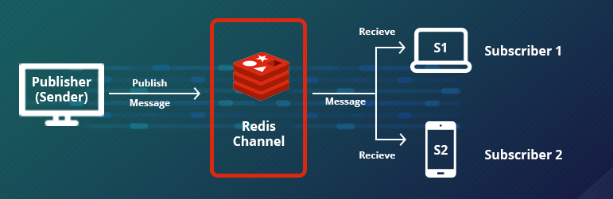





OIC Initiative – IntellijDoc Reviewer
OIC
Solution - Technical Architecture Overview
*Persona : System Admin, Content Creator
Upload Doc to Review
*Persona
Web Interface
Observability
Presentation
Dashboard /Access Control
API Layer (delegator)
Asynch-Event Driven MQ Layer
IBM SaaS Offering
IntelliDoc Engine
IBM Consulting Advantage
Gen AI Library
API Plugin
Knowledgebase
(SOP, Policies, Guidelines)
Data Integration Layer
IBM Watsonx
ai & data
KB connector
AI Multi-Agents Pipeline
Watsonx Adaptor
Review Feedback
LLM Layer
Feedback loop
RAG
DevOps (CI/CD)
Secured Platform
OCP on IBM Cloud

Slide 9
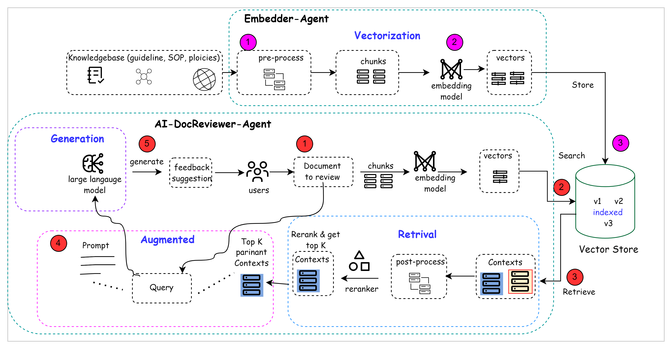
How Solution work with RAG..
.👥 Personas Explained
IntelliDoc Admin: Prepares and updates the knowledgebase via the Embedder Agent (offline).
IntelliDoc User:Uploads documents for real-time review via the AI-DocReviewer Agent.
Figure below shows two phase approach using two components :
Embedder-Agent: Vectorisations with steps :1 to 3
AI-Agent-DocReviewer : Retrieval-augmented Generation with steps : 1 to 5
Embedder Agent (Offline – Asynchronous)
Handles vectorization of the knowledgebase (guidelines, SOPs, policies).
Step | Description
🔵 1 | Pre-process documents: clean, normalize, prepare text
🟣 2 | Chunking: split into semantically meaningful parts
🟢 3 | Embedding model: convert chunks into vectors
→ Store | Vectors are stored in a Vector Store (e.g., MongoDB Atlas, Pinecone)
🔁 This component is reusable across any solution that requires vector-based knowledge ingestion.
AI-DocReviewer Agent (Online – Synchronous)
Handles document review in real-time using RAG.
Step | Description
🔴 1 | User uploads a document to review
🔴 2 | Document is embedded and searches relevant vectors in Vector DB
🔴 3 | Retrieve relevant top-K chunks (contexts)
🟣 4 | Rerank and post-process relevant knowledgebase content
🟢 5 | Generate review output using a Large Language Model (LLM)
→ Output | Suggestions, feedback, validations provided to the user
✔ It works with any vector DB and LLM that follows standard APIs — making it highly reusable.

Slide 10
Agents Reusability
Agent | Reusability Definition | Use-case | Example | Pre-requisites | High Potential Industries
Embedder Agent | Converts unstructured documents into vectorized format for semantic search across any domain | Knowledge ingestion for RAG/LLM pipelines | Vectorizing SOPs for AI-powered enterprise search | - Pre-cleaned documents - Domain tagging - Access to Vector DB - Chunking & Embedding pipeline | - Healthcare (clinical guidelines) - BFSI (risk policies) - IT (runbooks, tech docs)
AI-DocReviewer-Agent | Uses RAG + LLM to review any user document for alignment with domain-specific knowledge/policies | Document compliance review | Reviewing a contract for legal clause validation | - Embedded knowledgebase - Document parsing capability - Prompt templates - Feedback loop | - Legal (contract vetting) - Insurance (claim reviews) - Government (policy filing validation)

Slide 11
Reusability as a Standalone Component
Embedder Agent
How It Can Be Reused Separately:
Acts as a "knowledge ingestion engine" for any AI or RAG system.
Independent of the document review workflow — can run offline and on schedule.
You can use it in any LLM-based system that requires vector search.
AI-DocReviewer-Agent
How It Can Be Reused Separately:
Works with any existing vector store (e.g., from Embedder Agent, or a 3rd party source).
Doesn’t depend on having embedded the KB itself — just needs vectorized KB access.
Can run as an on-demand document analysis/review engine in different applications.
Standalone Reuse Scenarios:
Standalone Reuse Scenarios
Scenario | Description
Enterprise Chatbot | Embed internal documents to power a smart chatbot (e.g., HR policies, tech FAQs).
Semantic Search Engine | Build a search engine that retrieves content by meaning instead of keywords.
AI Assistant for Learning | Embed training materials for LLM to answer upskilling/reskilling queries.
Multi-lingual Translation Base | Embed documents in different languages for cross-lingual retrieval.
Scenario | Description
Resume Matcher | Review job applicants' resumes against job descriptions using existing vector DB.
Contract Validator | Validate vendor contracts against stored procurement standards (even from another org).
Student Assignment Grader | Auto-review student submissions against academic rubrics or knowledgebase.
Insurance Form Checker | Review submitted documents for completeness and compliance before claim processing.
Key Design Enablers for Independent Reuse
Capability | Embedder Agent | DocReviewer Agent
Works as microservice | ✅ | ✅
Can plug into different platforms | ✅ | ✅
Requires API only (not tightly coupled) | ✅ | ✅
Can scale independently | ✅ | ✅
Can be swapped or upgraded separately | ✅ | ✅

Slide 12





OIC Initiative – IntelliDoc Reviewer
OIC
UI Design
Generate Vector of each KB links
Manual Verification & Update
Automate Update Document on feedback and Publish
Dashboard
Develop KB Embedder and document Upload Interface
Persona : IntelliDoc User
Task: Implement a UI component that allows the user to verify the feedback manually and update the recommendations in the document he/she uploaded for review.
Details: Provide an interface with editable fields for the user to make necessary changes and a save button to update the recommendations.
Persona : IntelliDoc Admin
Task: Create a dashboard to show various charts.
Details: Include number of documents reviewed, accepted, published, failed for some period of times..
Persona : IntelliDoc Admin
Task: Develop a feature that processes the KB Doc links to create vector in Vector DB.
Details: Include a section in the UI where the generated KB Vector ID of individual KB link will be shown..
Persona : IntelliDoc User
Task: Create a feature to automate the update of document based on the reviewed feedback/recommendations and publish the updated content.
Details: Include a button or trigger in the UI that initiates the automated update and publishing process. Display a status indicator to inform the user about the progress.
Persona : IntelliDoc Admin
Task: Authenticate as Admin. Create a user interface that allows Knowledgebase (KB) Document links.
Details: Design a form with a multiple of bulk URL input field and a submit button.
Generate Review Feedback
Persona : IntelliDoc User
Task: Authenticate as user. Create a user interface that allows upload single or multiple Document to upload.
Details: Design a form with a multiple of bulk URL input field and a submit button.
Persona : IntelliDoc User
Task: Develop a feature that processes the uploaded document for review
Details: Include a section in the UI where the generated document upload JOBID for review and then click a hyper link to view the review feedback details

Slide 13
WBS
 | Check Points/Milestones | Work Item | Owner | Target End Date | Status | Remarks
 | Component Model/Architecture / Technical Design
 | Build/Development
 | 1. Embedder(Vectorization) | Knowledgebase Connector
 |  | Pre-process (Text Manipulation)
 |  | Chunks
 |  | Embedding/Vectorization
 |  | Vector DB Schema specification
 |  | Vector DB Indexing
 |  | Store in Vector DB
 |  | Event Driven Layer - Redis Channel (Asynch - pub-sub) for bulk/Realtime vectorization
 |  | Containerization & deployment
 |  | Unit Test
 | 2. AI-Agent-DocReviewer
 |  | API Layer - Expose API with Input target Doc to review
 |  | Chunks
 |  | Embedding/Vectors
 |  | Search
 |  | Retrieve & Context
 |  | Post-process
 |  | Rerank and top K pertinent Context
 |  | AI-Agent - Prompt engineering with Target Doc for review
 |  | API Response : LLM - Generate feedback Suggestion
 |  | Containerization & deployment
 |  | Unit Test
 | 3. UI / Dashboard
 | Deployment in Container Platform
 |  | Embedder Component
 |  | AI-Agent-DocReviewer
 |  | UI / Dashboard
 | End-to-End Integration
 | Wrap-up

Slide 14





Executive Champion
Leaders
Supal Chowdhury Executive IT Architect (L3)
supal.chowdhury@in.ibm.com
Anand Bhushan
Senior IT Architect - Hybrid Cloud Transformation | AI | Automation | Security
anand.bhushan@in.ibm.com
A B Vijay Kumar IBM Fellow
kvijay@in.ibm.com
Co-Creators
Sponsors
Cheranellore(Vasu) Vasudevan
Senior Technical Staff Member (STSM), Enterprise Data
vasuv@us.ibm.com
All Volunteers To be added

